Slide 1
Module 1 - Introduction to Data Science

Slide 2




Data All Around
Lots of data is being collected and warehoused
Web data, e-commerce
Financial transactions, bank/credit transactions
Online trading and purchasing
Social Network

Slide 3
Big Data
Big Data is any data that is expensive to manage and hard to extract value from
Volume
The size of the data
Velocity
The latency of data processing relative to the growing demand for interactivity
Variety and Complexity
the diversity of sources, formats, quality, structures.

Slide 4
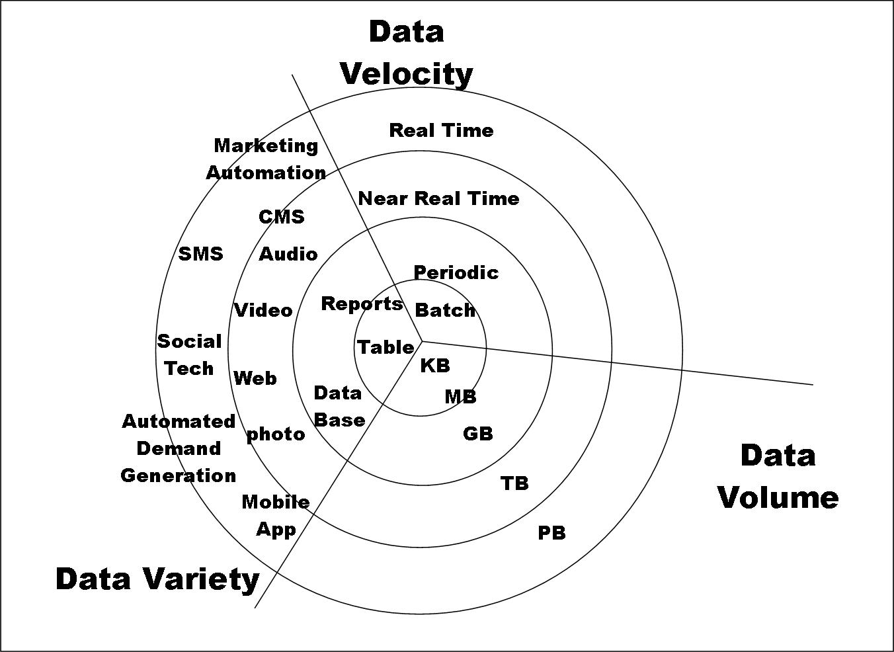
Big Data

Slide 5
Types of Data We Have
Relational Data (Tables/Transaction/Legacy Data)
Text Data (Web)
Semi-structured Data (XML)
Graph Data
Social Network, Semantic Web (RDF), …
Streaming Data

Slide 6
What To Do With These Data?
Aggregation and Statistics
Data warehousing and OLAP
Indexing, Searching, and Querying
Keyword based search
Pattern matching (XML/RDF)
Knowledge discovery
Data Mining
Statistical Modeling

Slide 7
What is Data Science?
An area that manages, manipulates, extracts, and interprets knowledge from tremendous amount of data
Data science (DS) is a multidisciplinary field of study with goal to address the challenges in big data
Data science principles apply to all data – big and small
https://hbr.org/2012/10/data-scientist-the-sexiest-job-of-the-21st-century/

Slide 8

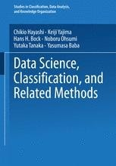
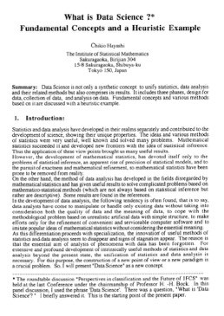
WHAT IS DATA SCIENCE?
“Data science, also known as data-driven science, is an interdisciplinary field of scientific methods, processes, algorithms and systems to extract knowledge or insights from data in various forms, either structured or unstructured, similar to data mining.”
“Data science intends to analyze and understand actual phenomena with ‘data’. In other words, the aim of data science is to reveal the features or the hidden structure of complicated natural, human, and social phenomena with data from a different point of view from the established or traditional theory and method.”
5

Slide 9
What is Data Science?
Theories and techniques from many fields and disciplines are used to investigate and analyze a large amount of data to help decision makers in many industries such as science, engineering, economics, politics, finance, and education
Computer Science
Pattern recognition, visualization, data warehousing, High performance computing, Databases, AI
Mathematics
Mathematical Modeling
Statistics
Statistical and Stochastic modeling, Probability.

Slide 10
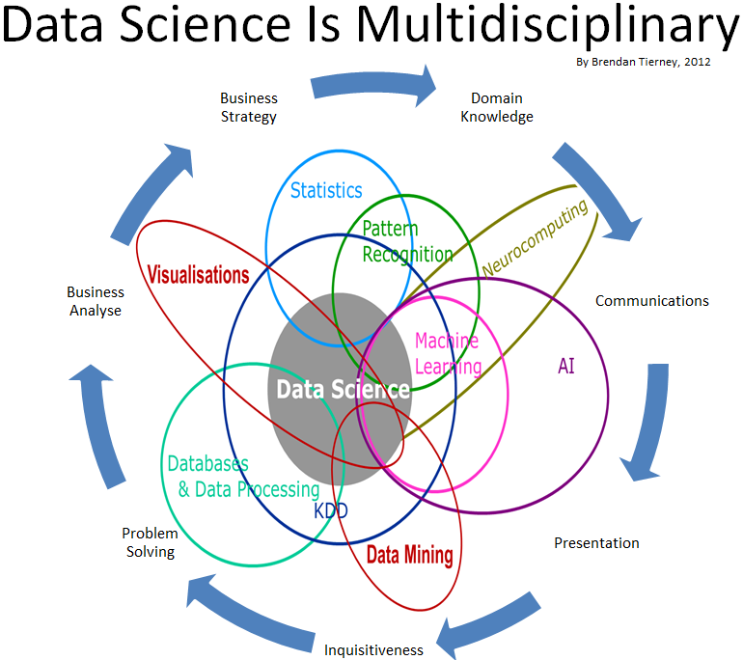
Data Science

Slide 11
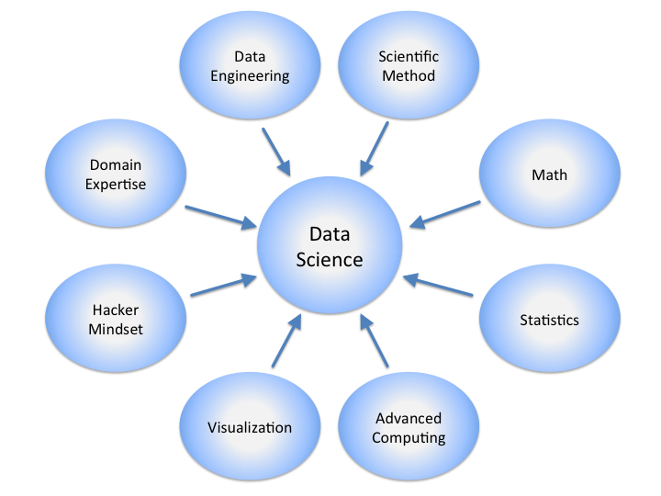
Data Science

Slide 12


DATA SCIENCE AND ARTIFICIAL INTELLIGENCE
Data Science
ML/DM/ Analytics
Artificial Intelligence
“Data science produces insights.
Machine learning produces predictions”
Canadian Data Science Workshop
10

Slide 13
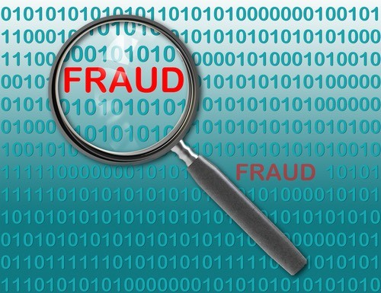
DATA SCIENCE APPLICATION EXAMPLES
Fraud detection
Investigate fraud patterns in past data
Early detection is important
Before damage propagates
Harder than late detection
Precision is important
False positive and false negative are both bad
Real-time analytics
11

Slide 14
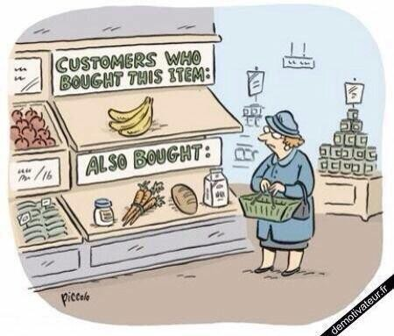
DATA SCIENCE APPLICATION EXAMPLES
Recommender systems
The ability to offer unique personalized service
Increase sales, click-through rates, conversions, …
Netflix recommender system valued at
$1B per year
Amazon recommender system drives a 20-35% lift in sales annually
Collaborative filtering at scale
12

Slide 15

DATA SCIENCE APPLICATION EXAMPLES
Predicting why patients are being readmitted
Reduce costs
Improve population health
Find the “why” behind specific populations being readmitted
Data lakes of multiple data sources
Investigate ties between readmission an socioeconomic data points, patient history, genetics, …
d
13

Slide 16
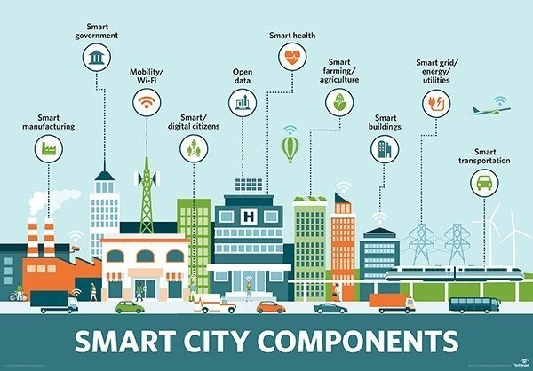
DATA SCIENCE APPLICATION EXAMPLES
“Smart cities”
Not well-defined
Canadian Data Science Workshop
14

Slide 17
Real Life Examples
Companies learn your secrets, shopping patterns, and preferences
For example, can we know if a woman is pregnant, even if she doesn’t want us to know? Target case study
Data Science and election
Data Science and fraud detection
Data Science and Prediction
…….

Slide 18
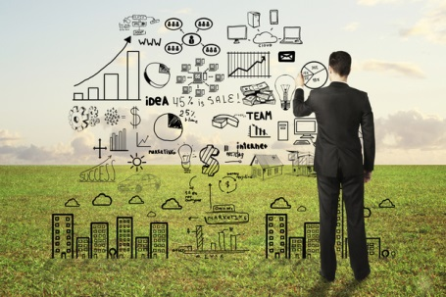
Data Scientists
Data Scientist
They find stories, extract knowledge. They are not reporters

Slide 19

Data Scientists
Data scientists are the key to realizing the opportunities presented by big data. They bring structure to it, find compelling patterns in it, and advise executives on the implications for products, processes, and decisions

Slide 20
What other Job Roles
Data Scientist
Data Engineer
Data Analyst
ML Engineer/Architect
Data Architect
Business Data Analyst
And more……

Slide 21
What do Data Scientists do?
National Security
Cyber Security
Business Analytics
Engineering
Healthcare
And more ….

Slide 22
Concentration in Data Science
Mathematics and Applied Mathematics
Applied Statistics/Data Analysis
Solid Programming Skills (R, Python, Julia, SQL)
Data Mining
Data Base Storage and Management
Machine Learning and discovery

Slide 23


HOLISTIC APPROACH TO DATA SCIENCE
Core
Data Security & Privacy
Data
Making Data Trustable & Usable
Data
Management of Big Data
Modeling & Analysis
Dissemination & Visualization
Acquisition
Preservation
Ethics, Policy & Social Impact
Application
Application
Application
Application
16

Slide 24
CORE RESEARCH ISSUES & INTERACTIONS
Making Data Trustable & Usable
Big Data Management
Modelling & Analysis
Data
Visualization & Dissemination
17

Slide 25
CORE RESEARCH ISSUES & INTERACTIONS
Data cleaning
Sampling
Data provenance
Making Data Trustable & Usable
Big Data Management
Modelling & Analysis
Data
Visualization & Dissemination
17

Slide 26
CORE RESEARCH ISSUES & INTERACTIONS
Data cleaning
Sampling
Data provenance
Making Data Trustable & Usable
Data lakes
Batch & online access
Platforms
Big Data Management
Modelling & Analysis
Data
Visualization & Dissemination
17

Slide 27
CORE RESEARCH ISSUES & INTERACTIONS
Data cleaning
Sampling
Data provenance
Making Data Trustable & Usable
Data lakes
Batch & online access
Platforms
Big Data Management
Modelling & Analysis
Models & methods for data lakes
Unsupervised classification & AI
Data
Visualization &
Dissemination
17

Slide 28
CORE RESEARCH ISSUES & INTERACTIONS
Data cleaning
Sampling
Data provenance
Making Data Trustable & Usable
Data lakes
Batch & online access
Platforms
Big Data Management
Modelling & Analysis
Visualization for wider audience
Visualization for data exploration
Models & methods for data lakes
Unsupervised classification & AI
Data
•
Open data technologies
Visualization &
Dissemination
17

Slide 29
CORE RESEARCH ISSUES & INTERACTIONS
Data cleaning
Sampling
Data provenance
Making Data Trustable & Usable
DM support for provenance
Data preparation for big data management
Data lakes
Batch & online access
Platforms
Big Data• Cleaning for data
Modelling & Analysis
Managementanalysis
DM for ML
ML for DM
Visual analytics
…
Data
Visualization for wider audience
Visualization for data exploration
Models & methods for data lakes
Unsupervised classification & AI
•
Open data technologies
Visualization &
Dissemination
17

